Slide 1





MAMC01901 Business Analysis
Week 5 (Session 1): Business analysis techniques (Stakeholder Analysis)

Slide 2



Agenda
Stakeholder analysis
Class activity
Assessment 2

Slide 3
Stakeholder Analysis
What is stakeholder analysis?
Stakeholders are individuals, groups, or organisations that are affected by or can affect a project.
Stakeholder analysis helps identify:
Who the stakeholders are, and who are the key ones
Their interests and influence
How to manage their engagement

Slide 4
Stakeholder Analysis
Why is stakeholder analysis important?
Helps ensure project success by understanding what their expectations are
Identifies potential risks or resistance early
Builds trust and better communication
Helps prioritise stakeholder management efforts (can do that using a power/interest grid)

Slide 5
Stakeholder Analysis Process
Step 1: Identify Stakeholders
Brainstorm or list all individuals, groups, or organisations impacted by or who can impact the project.
Sources: Organisational charts, past project documents, interviews, business case.
Step 2: Analyse Stakeholders
Assess each stakeholder’s:
Power: How much influence they have over decisions
Interest: How much they care about the project’s outcome

Slide 6
Stakeholder Analysis Process
Step 3: Prioritise Stakeholders
Plot them on the Power/Interest Grid to categorise them:
Manage Closely
Keep Satisfied
Keep Informed
Monitor
Outcome: Clear visual of engagement priorities
Step 4: Develop Engagement Strategies
Tailor communication and involvement tactics based on their quadrant.
Consider:
Frequency and format of communication
What to share and when
Who should engage (e.g., BA, PM, Sponsor)

Slide 7
Stakeholder Analysis Process
Step 5: Monitor and Review
Stakeholder roles and attitudes may evolve.
Revisit and update your analysis throughout the project.
Check-in regularly during key milestones or changes

Slide 8
Stakeholder Analysis Process
How to Identify Stakeholders?
Brainstorm internally
Review documentation
Consult existing project teams
Interview stakeholders
Ask: who will be impacted or has influence?
Once you have identified who your stakeholders are, you can then categorise them into the power/interest grid.

Slide 9
Stakeholder Analysis Process
Power/Interest Grid
A simple tool to categorise stakeholders based on:
Power: their ability to influence the project
Interest: their level of concern or involvement in the project
Influence in the project vs their actual interest or involvement in it.

Slide 10
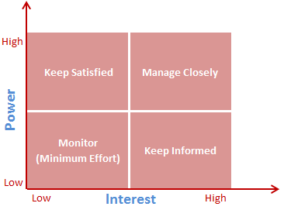
Power/Interest Grid

Slide 11
Power/Interest Grid
Example: change check out process, so decided to implement a self-checkout kiosk at a supermarket
Start by identifying stakeholders
Categorise them on the power/interest grid
Stakeholders:
Supermarket cashiers/staff
Project sponsor
Compliance officer
General public

Slide 12
Power/Interest Grid
Example: change check out process, so decided to implement a self-checkout kiosk at a supermarket
High Power, High Interest – Manage Closely
Project Sponsor is typically a senior leader driving the implementation of the new system. They fund the project and are keenly interested in its outcome. Must be kept in the loop with regular updates and consulted on key decisions.
High Power, Low Interest – Keep Satisfied
Compliance Officer has authority to block or delay the project if necessary, but isn't involved in the day-to-day. Keep them satisfied with occasional updates and involve only when needed.

Slide 13
Power/Interest Grid
Example: change check out process, so decided to implement a self-checkout kiosk at a supermarket
Low Power, High Interest – Keep Informed
Supermarket Cashiers aren’t decision-makers, but they care a lot because the new system impacts their daily work. Keep them informed and gather feedback.
Low Power, Low Interest – Monitor
General Public are not directly involved in the project and don’t have much influence, but it is good to keep an eye on them since you’re changing how customers interact with the supermarket.

Slide 14
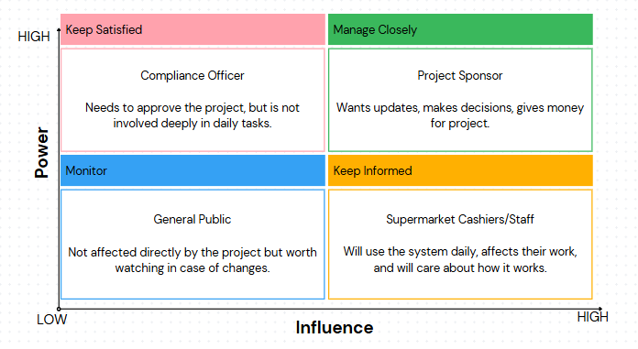
Power/Interest Grid

Slide 15
Class Activity
Read the vehicle rental company’s case study (in Teams under Class Activities).
Identify the main issue that they are facing from the case study
Identify the most important stakeholders from the case study who will be directly affected
Categorise them into a power/interest grid
Provide a justification for your categorisation
.

Slide 16
Assessment 2
Critically evaluate the role of a business analyst in the chosen organisation.
Critically analyse at least two contemporary organisational issues that the organisation may face or is currently facing.
Critically apply at least two business analysis techniques to evaluate the issues faced by the organisation.
Propose and critically justify the alignment of solutions to the issues with the organisation’s strategic goals.
.

Slide 17
Assessment 2
Critically evaluate the role of a business analyst in the chosen organisation.
Needs to be more detailed compared to 1st assessment. Mention in good detail what is the role of the business analyst in the organisation, what are their activities, how does the BA add value.
Critically analyse at least two contemporary organisational issues that the organisation may face or is currently facing.
Identify 2 organisational issues and think about how you can use SWOT analysis, fishbone diagram, 5 why’s or stakeholder analysis to evaluate those issues.
.

Slide 18
Assessment 2
How to Use Stakeholder Analysis in the Report
Choose an issue where people are directly involved or affected (e.g., implementing a new system, undergoing change, customer service problems, compliance delays).
Explain why stakeholder involvement is critical to solving this issue.
Identify the key stakeholders involved in or affected by the issue.
Use the Power/Interest Grid to classify them.
Discuss how these positions were determined (based on role, influence, visibility, or interest in the outcome).
Explain how stakeholder roles, interests, or resistance contribute to the issue.
Propose targeted engagement strategies based on the stakeholder grid.
Justify why is it so important to know who our stakeholders are in order to address the issue.
.

